Slide 1
Case Study:
A Leading Innovator of Mobile Technology
By: Samuel Cheng
USC MCL Short Course: Entrepreneurships for Engineering Students
Instructor: Professor Jay Kuo

Slide 2
History (1)
1985: Qualcomm Was Founded
1989: Proved CDMA To Public
1991: Went Public
1993: Sent Data Packet Over CDMA
1996: CDMA Introduced World Wide
1998: First CDMA Smartphone
1999: CDMA2000 Became 3G Standard

Slide 3
History (2)
2005: Scorpion processor released
2007: Became Largest Mobile Chipset Developer
2007: Snapdragon released
2008: First HSPA+ Data Call
2011: Qualcomm Acquired Atheros
2013: Snapdragon Used For First LTE-A Smartphone

Slide 4
Quality Communications (1)
Started Out As Telecommunications Company Based In San Diego
Worked On CDMA Technology
GSM was leading
CDMA Vs GSM
CDMA adopted by Verizon and Sprint
M2M Communication
omniTRACS is a satellite-based communications system commercially used for vehicle tracking
3.5G Technology
HSPA & HSPA+
Download speeds up to 63 Mbps

Slide 5
Quality Communications (2)
Chipset Technology
System on Chip
Snapdragon
Mobile Network Modem
Smartphone Processor
Scorpion
Krait
Internet Of Everything (IOE)
Wearables
Cars
Homes
One Goal: Invent Mobile Technology Breakthroughs

Slide 6
What Does Qualcomm Profit From?
Most From Mobile Device Chipsets
4G, 3G, 2G chipset such as Gobi
Snapdragon Processors
Problems with overheating of current flagship processor Snapdragon 810
Some From Royalties Due To CDMA Patents
People need CDMA for places without LTE
Average royalty rate of 3.2% from mobile
devices (2013)

Slide 7
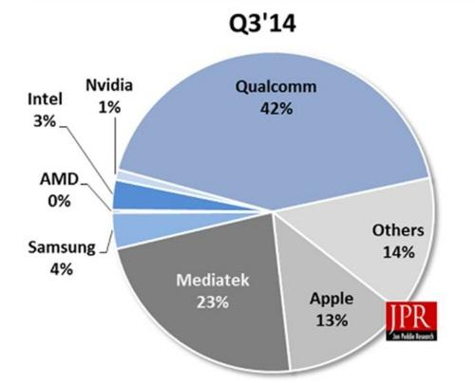
Competition
Chipset
MediaTek
Intel
Samsung
Nvidia
Spreadtrum
Mobile Network
Transition from 3G to 4G technology
CDMA not used in 4G, OFDMA is used
Source: http://img.deusm.com/eetimes/2014/12/1324864/Mobile-graphics-market-shares.jpg

Slide 8
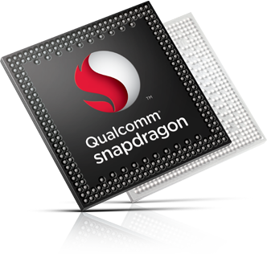
What Makes Qualcomm Successful?
Powerful Mobile Chipsets
Everyone wants a fast phone
Snapdragon 810 is 64 bit, 8 cores, up to 2 Ghz
CDMA Technology
Main developer of CDMA products

Slide 9
Culture
Diverse Employee Culture
Welcomes employees of various backgrounds
Work Environment
“In order to foster an environment where invention thrives, we must foster one where our people do too” – Qualcomm Life and Culture
Fitness and Wellness Facilities

Slide 10
Future Of Qualcomm
Further Development Of The Internet Of Things
Make Everything Smart
5G Standard
Faster Data Speeds
Power Efficient Mobile Chips

Slide 11
Thank You

