Slide 1
Bai Du
Yuzhuo Ren
Advisor : Professor C.-C. Jay Kuo

Slide 2
Overview
Basic Information
Management
Business Model
Operation Model
1

Slide 3
Basic Information
2

Slide 4
Basic Information
In 1991, Li graduated from Peking University specialized in information management
In 1994, Li received master degree at University at Buffalo, the State University of New York
From 1994 to 1997, Li worked in IDD information Services, developed algorithm for search engine page ranking
From 1997 to 1999, Li worked for Infoseek,
a pioneer internet search engine company.
He achieved picture search function used by
Go.com.
Robin Li
3

Slide 5
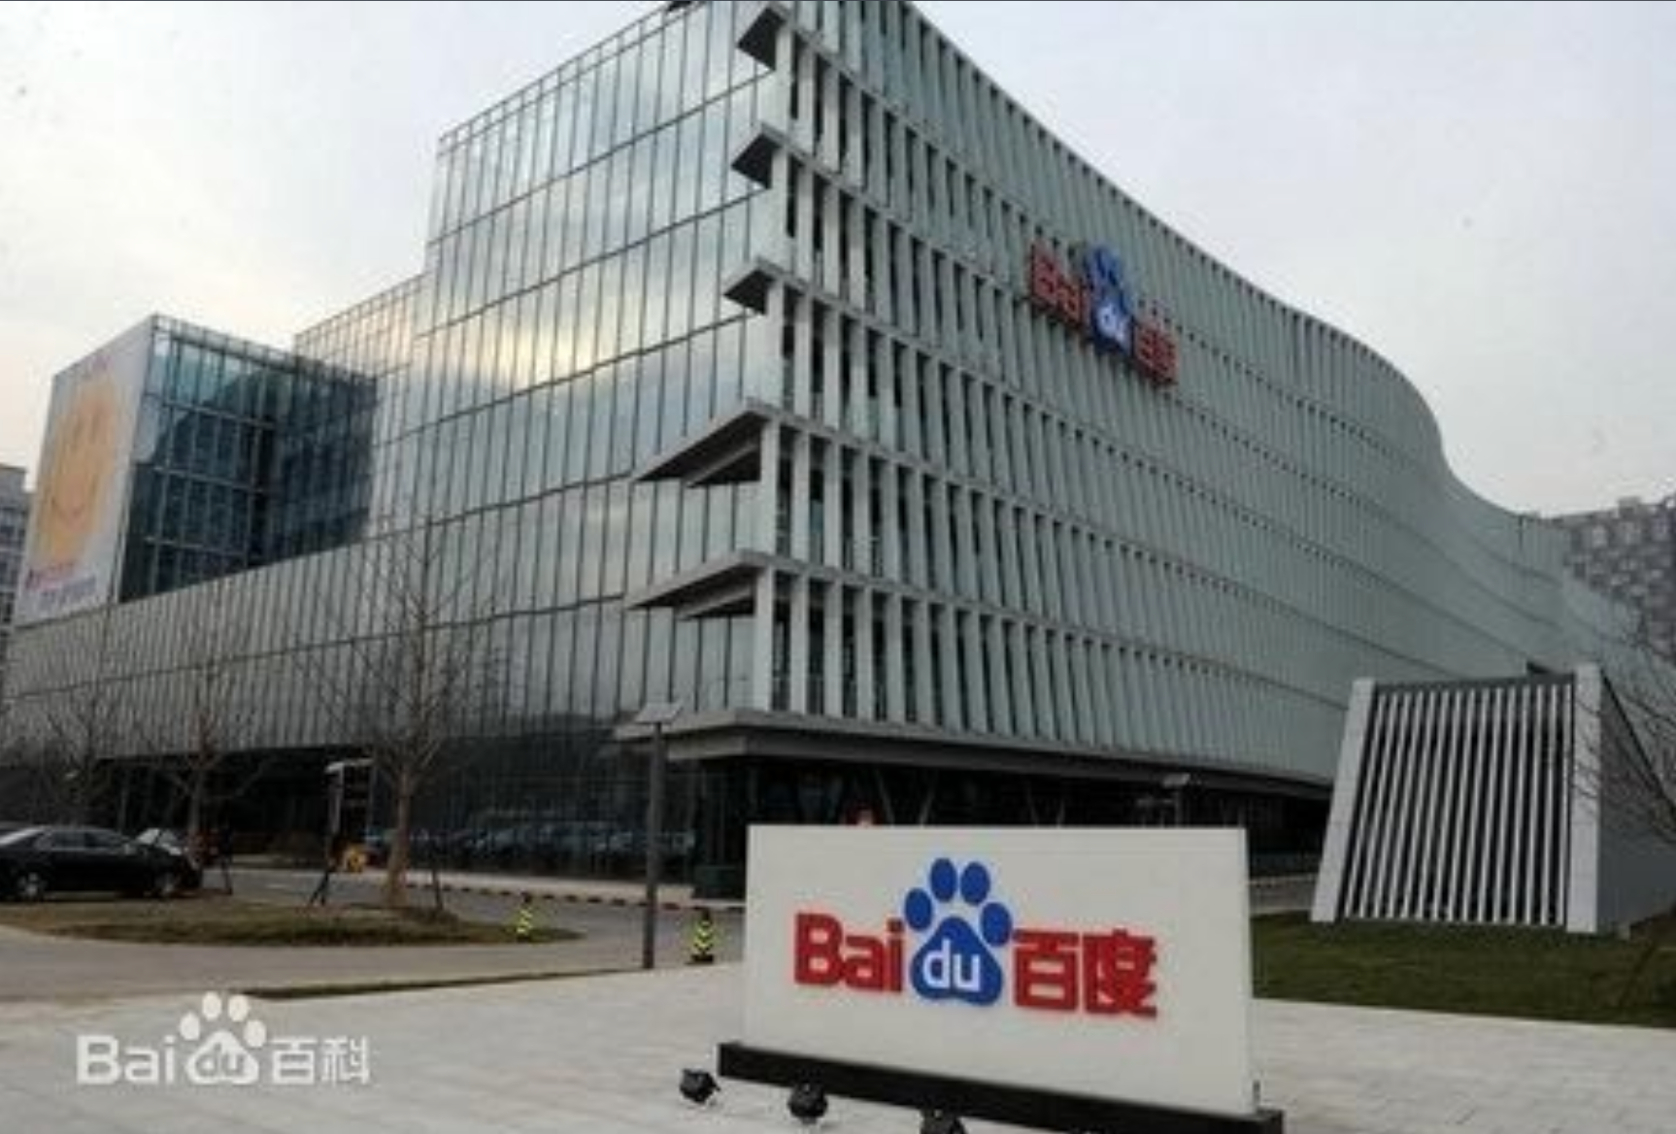
Basic Information
2000 Founded by Robin Li
2001 Started search engine service
2003 Became the largest search engine in China
2005 Completed IPO on NASDAQ, became the largest Chinese website
2006-now develop new products and focus innovation
4

Slide 6
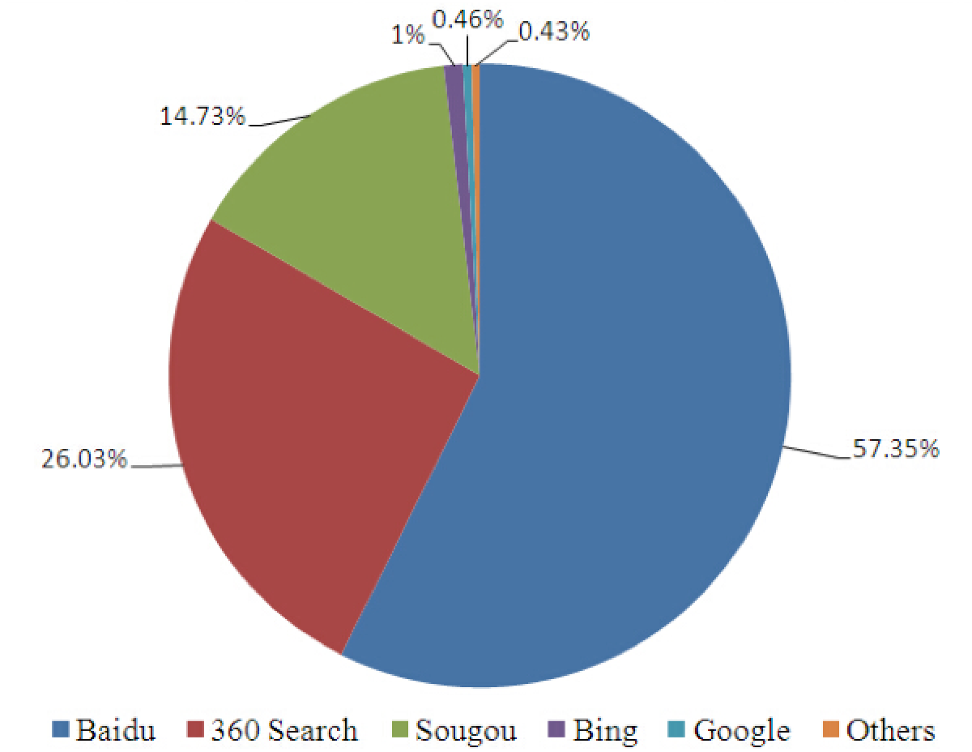
Basic Information
Chinese PC search market sharing (2014)
5

Slide 7
Management
Management
Board of Directors
6

Slide 8
Robin Li
Co-Founder, Chairman and CEO
Strategy & business operations
Hailong Xiang
Vice President
Commercial product, human resource, service management
Jing Wang
Vice President of Engineering
R&D, mobile Internet & infrastructure
Guang Zhu
Vice President
Marketing, public relations
Jennifer Li
Chief Financial Officer
Finance accounting, human resource
Zhan Wang
Vice President
Direct sales, channel sales & key accounts
Lee Liu
Vice President of HR
Human resource, general administration
Victor Liang
Vice President
Legal affairs, policy research
7

Slide 9
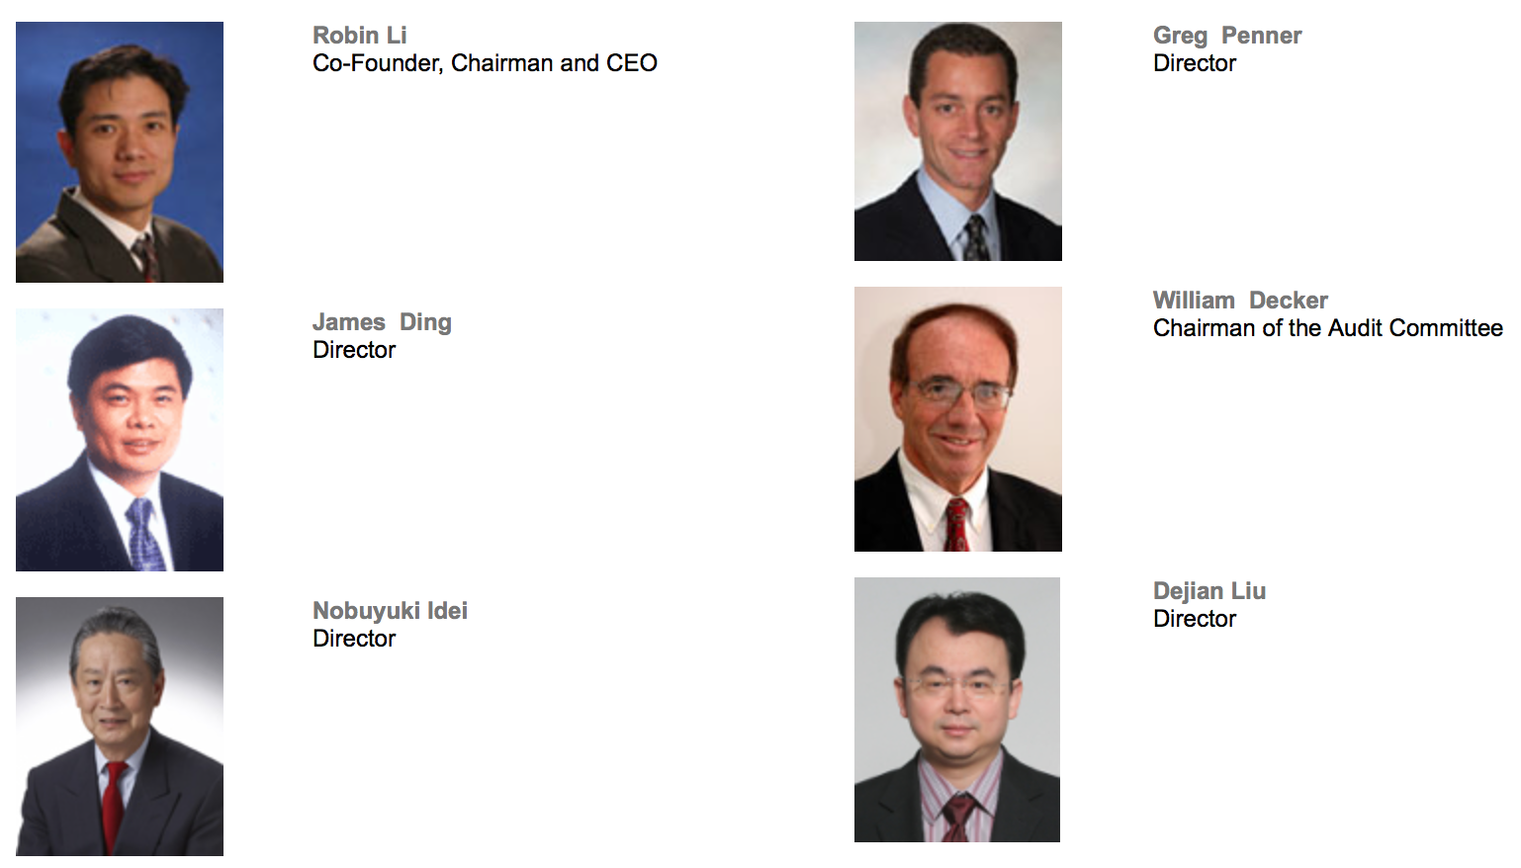
Board of directors
8

Slide 10
Business Model
Goals
Product Introduction
Profit Model
9

Slide 11
Goals
Strategy Goal:
Provide the best and most convenient way for people to find what they are looking for
Become an outstanding representative Chinese network technology company in the world
User’s Goal:
Target mainly Chinese netizen
10

Slide 12
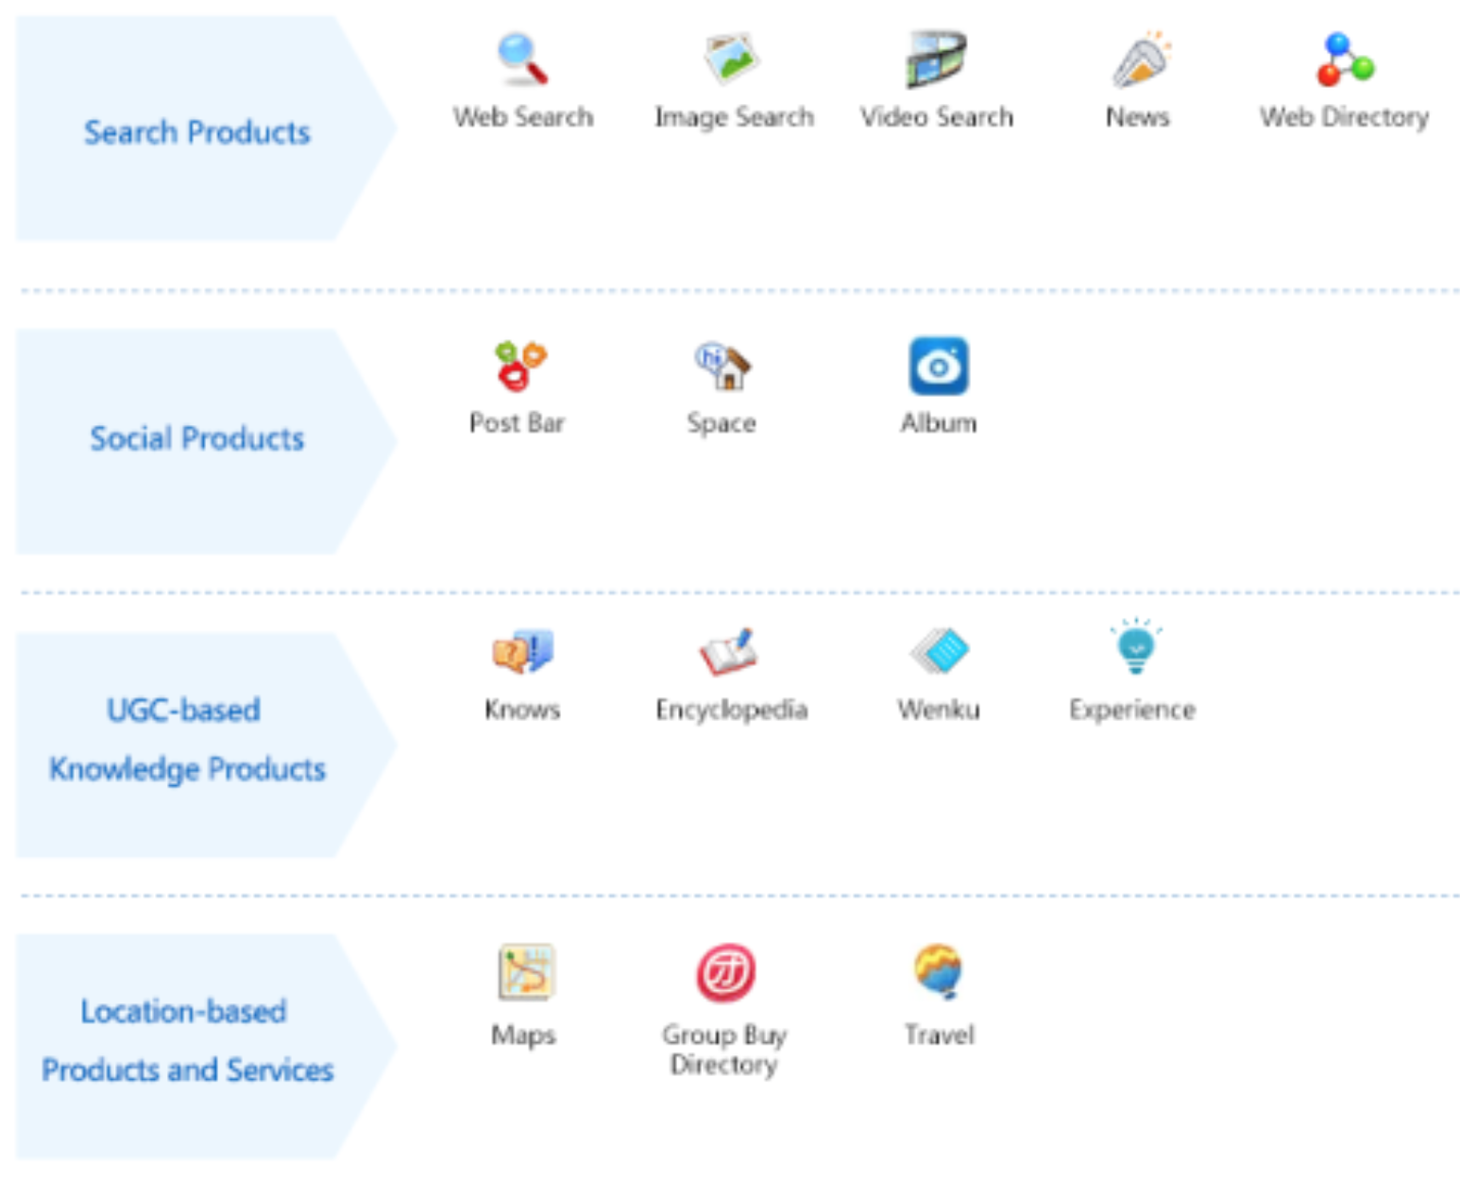
Product Introduction
66 search and community services including Baidu Post Bar, Baidu Internet TV and etc…
11

Slide 13
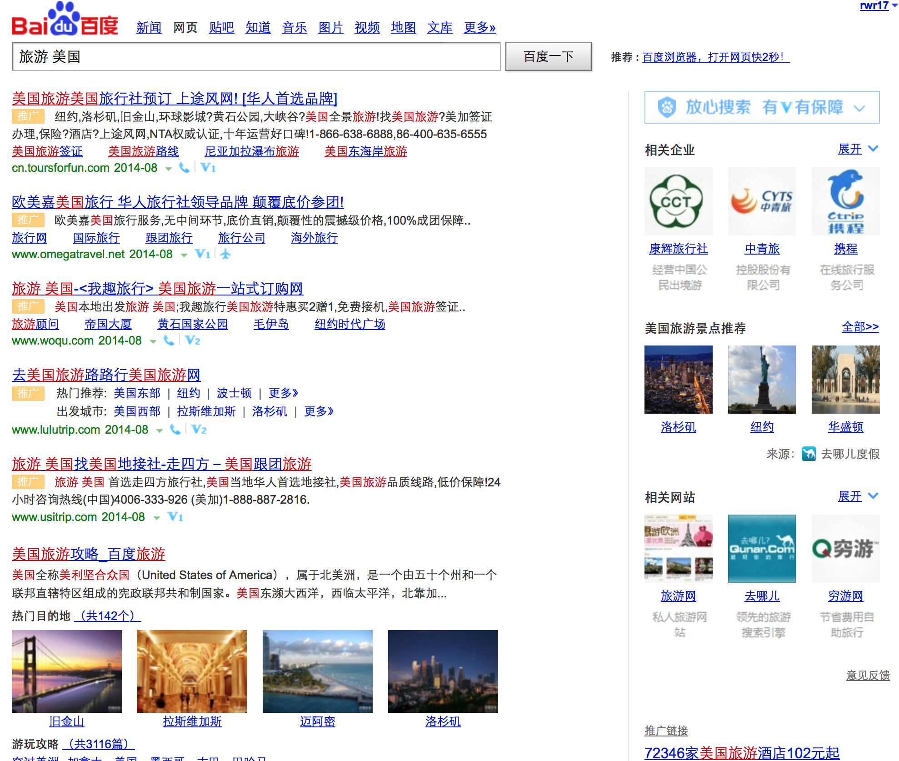
Profit Model: Key-word Bidding (Baidu)
“travel to America”
Promotional Link
Original search result
Paid Ads are listed as needed
12
Notes:
Profit model
Bidding Rank：
it is a method of web information promotion paid by how many potential guests it can bring to the company. The company will pay only when the promotion information is clicked by the user. Therefore, it is highly related to the content retrieved by the user. The company can flexible control the money on the information promotion. Meanwhile, key-word bidding strategy
http://baike.baidu.com/view/40571.htm?fr=aladdin
This is the main revenue for Baidu company
Mobile phone mobile search
Fixed rankings
Baidu’s Phoenix Nest (PPC platform)
Paid adds can appear both above and below the original search results
Core capabilities
Baidu promotion: Baidu promotion is a kind of pay for performance of the network promotion, with a small amount of input to the enterprise can bring a lot of potential customers, enhance the enterprise sales and brand awareness.
Baidu Marketing Center: Baidu marketing center is a one-stop information service platform Baidu meticulously for entrepreneurs. Here, you can in each link Baidu promotion information, grasp the pulse, find solutions.
Brand marketing: As the world's largest Chinese search engine, Baidu with powerful Internet users search the database, users can clear insight into the consumption demand and consumption patterns, to become the ROI media platform Chinese "most understand consumers“.
Baidu Alliance:
Build Chinese integrity of Internet, professional, trustworthy pan media platform, help partners successful in their respective fields.

Slide 14
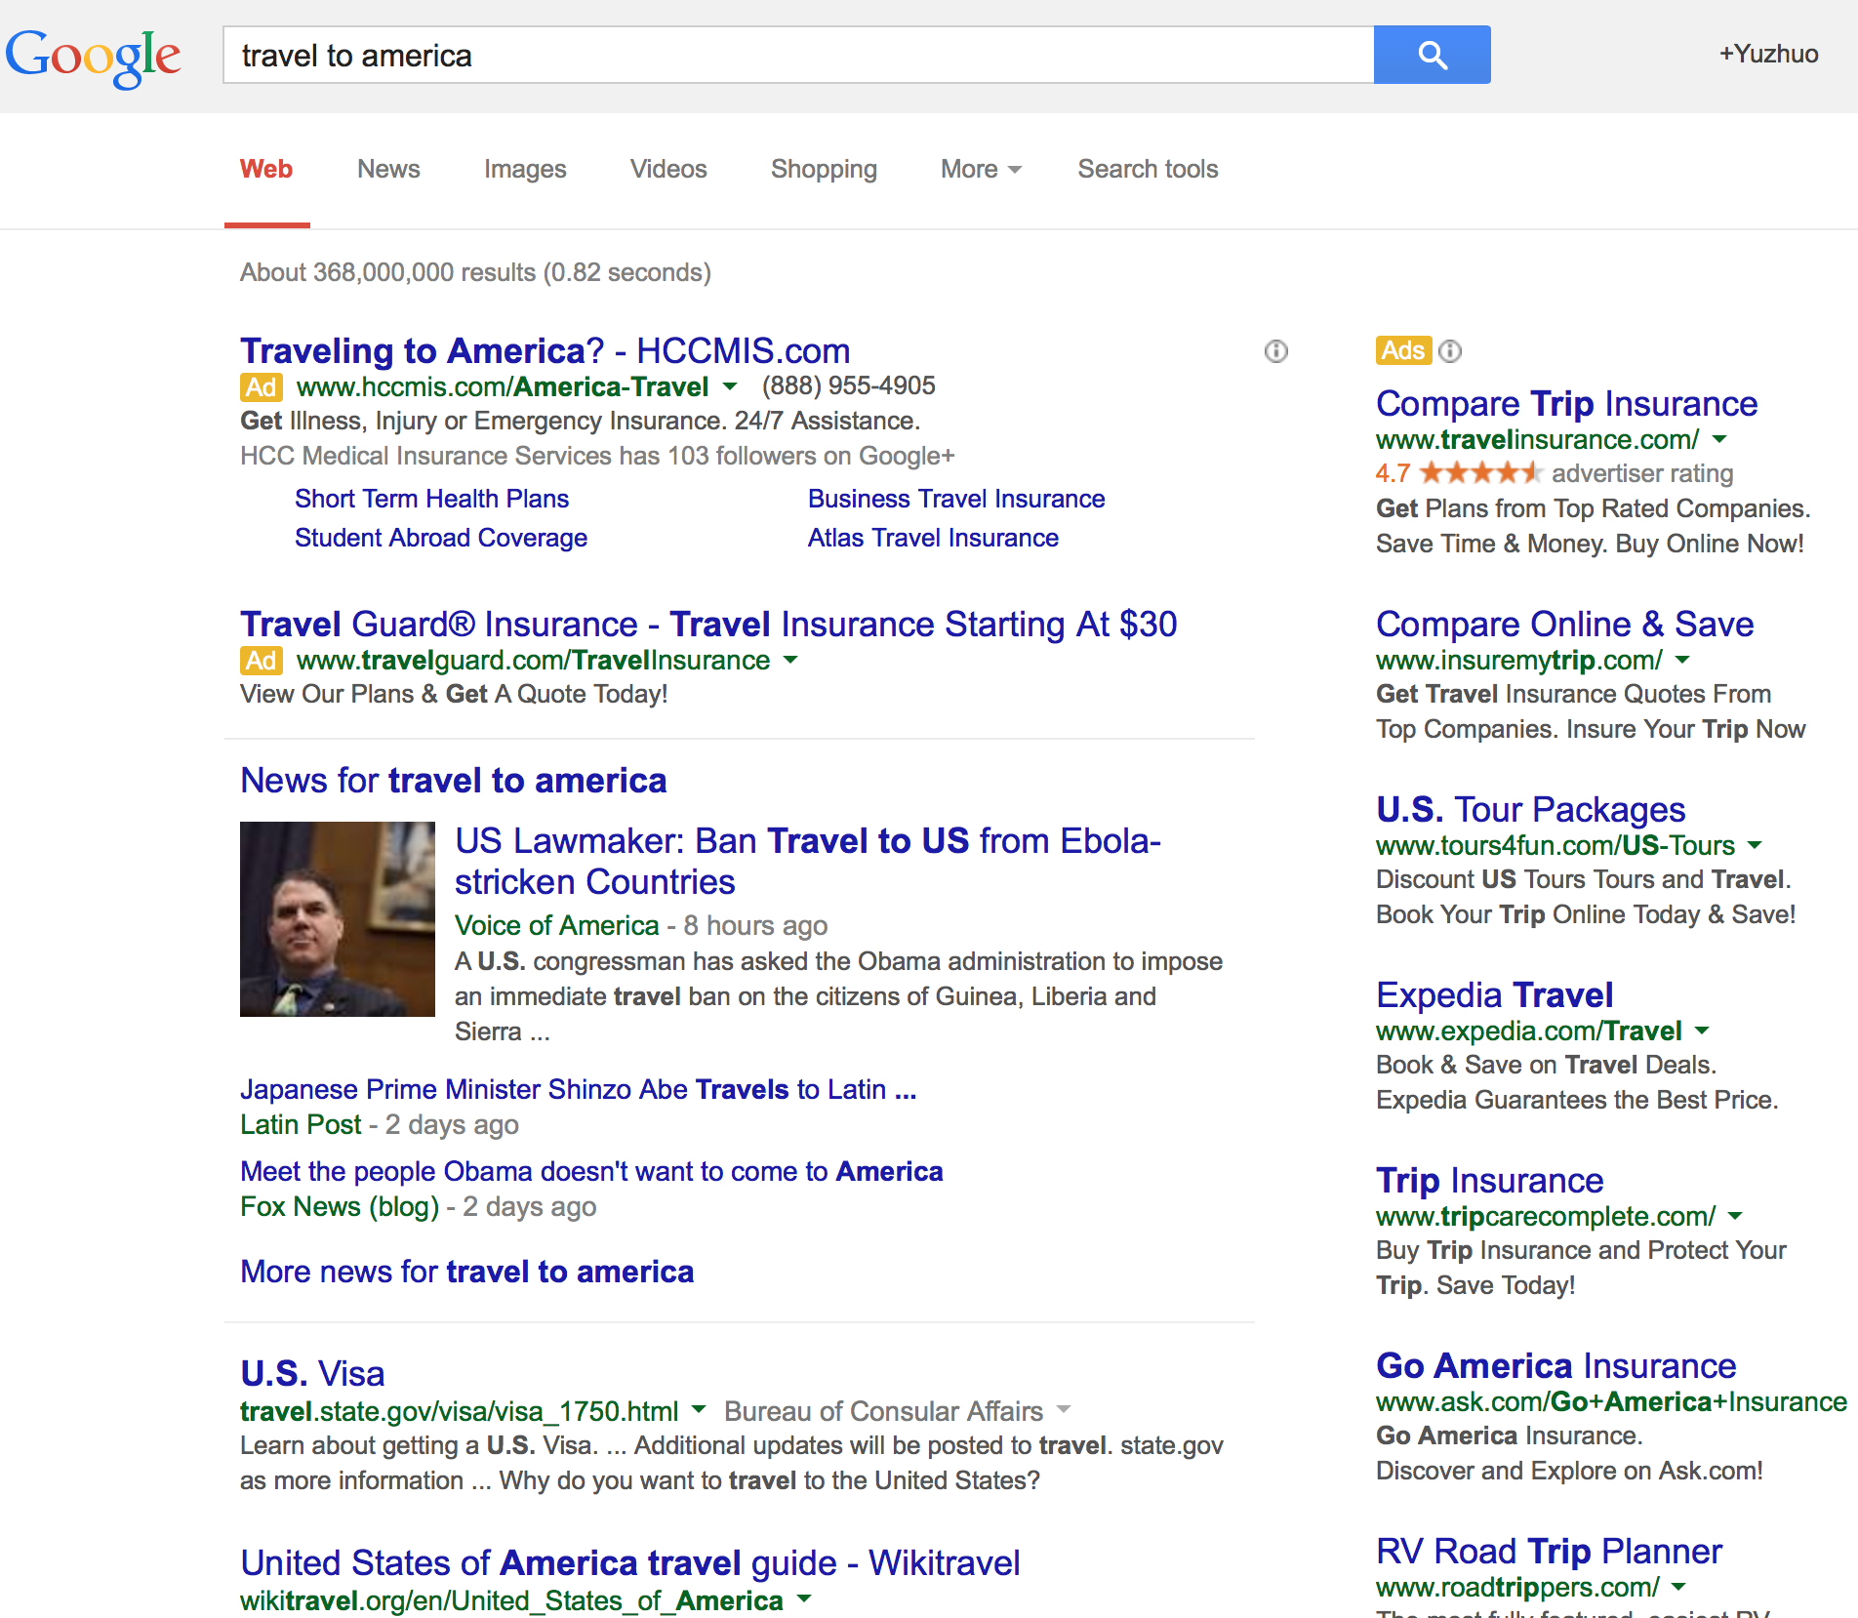
Profit Model: Adwords (Google)
Paid advertisement
Original search result
13
Notes:
Google’s adword model
Advertisement are advanced before all the original search results
Original search results are unpaid, generated by the algorithm
Google includes Ad position in adwords quality score calculation: as click through rate (CTR) is one of the most important factors in ranking ads, and normally the higher ad ranks, the more clicks the ad gets.

Slide 15
Profit Model: Mobile Search
The revenue of the mobile Internet business was 10% of the total revenue income
14
Notes:
Investment accounted for 25% of all research funding

Slide 16
Profit Model: Mobile Search - Strategy
Cloud search engine
Mobile advertising
Sina mobile search partnership
Android platform based browser
15
Notes:
A. Platform category (based on the Cloud, including Baidu Cloud storage, Cloud computing, Data intelligence three major Cloud core strategies):
• BEA (Baidu’s Cloud search engine); • PCS (Baidu’s Cloud storage service); • MTC (Baidu’s Cloud mobile test platform).
B. Application category:
• Mobile advertising (should be the main source of Baidu’s mobile services revenue), charged in accordance with the click-through rate and other marketing sales parameters;
• Sina (Sina Inc., www.sina.com, Internet portal company) mobile search partnership, charged in accordance with the ranking of corporate in search service (such as: corporate price ranking, enterprise precision marketing applications and applications recommendation);
• Android platform based browser, charged in accordance with the per user license basis.

Slide 17
Profit Model: Fix Ranking
Company pay for the ranking by key-words
Notes:
A. Platform category (based on the Cloud, including Baidu Cloud storage, Cloud computing, Data intelligence three major Cloud core strategies):
• BEA (Baidu’s Cloud search engine); • PCS (Baidu’s Cloud storage service); • MTC (Baidu’s Cloud mobile test platform).
B. Application category:
• Mobile advertising (should be the main source of Baidu’s mobile services revenue), charged in accordance with the click-through rate and other marketing sales parameters;
• Sina (Sina Inc., www.sina.com, Internet portal company) mobile search partnership, charged in accordance with the ranking of corporate in search service (such as: corporate price ranking, enterprise precision marketing applications and applications recommendation);
• Android platform based browser, charged in accordance with the per user license basis.

Slide 18
Operation model
Domestic Market Management
Globalization Management
Reputation Management
User-centric Management
16

Slide 19
Operation model
Domestic Market Management
Once a 80% market share of China’s PC search market
73% of the combined mobile & PC search market (2014)
Globalization Management
Baidu Japan, Baidu Brasil
Reputation Management
Provide company the best promotion strategy
Provide diversified products
User-centric Management
Provide people the most convenient way to access information
Diversified function available, vertical search etc
17
Notes:
baidu once had a commanding 80% market share of China’s PC search market. Baidu still commands 73% of the combined mobile/ PC search market.
Localized management:
At present Baidu search engine market share reached 77% in Chinese, provide a cost-effective and efficient promotion platform for Chinese 300000 small and medium enterprises.
Globalization management:
Baidu Japan's success is to showcase the Baidu has to.
User-centered management:
Provide people the most the people the most convenient access to information, to find what we seek as its mission" to the concept of user guide.
Reputation management:
As the world‘s largest Chinese search engine, Baidu has the huge users’ search database, the dataset can help clear reflects users’needs and consumption preference
%Baidu has became "Chinese most understand consumer POI media platform.

Slide 20
Reference
http://ir.baidu.com/phoenix.zhtml?c=188488&p=irol-products
http://lhx125.wordpress.com/2012/10/07/a-brief-analysis-of-baidus-profit-model-and-its-strategic-direction-in-the-mobile-internet-era-2/

Slide 21
Thank you ! QUESTIONS?

