Slide 1
A short introduction
William Song

Slide 2
The Beginning
Founded in 2004 by Mark Zuckerberg, a student at Harvard University
The first version of Facebook was built in two weeks
Three months later, Facebook had over 100,000 users
Notes:
Mark wanted to “bring the college experience online”
Vision, focus and execution vs. competitors

Slide 3
Fast-forward ten years…

Slide 4
Today
Facebook has 1.28 billion users (monthly active, in March 2014)
4.5 billion Likes and Comments per day
350 million photos uploaded per day
$7.87 billion in revenue in 2013

Slide 5
It is making the world more open and connected
It is not just a social network – it is positioning itself as the foundation of the entire social web
Notes:
Facebook’s user base keeps growing, and nearly a fifth of the time that Americans spend on their smartphones is spent on Facebook.

Slide 6
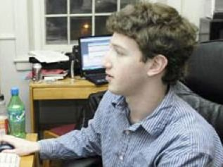
Secrets to success
Move fast
Notes:
Mark Zuckerberg built the first version of Facebook in his spare time in his Harvard dorm room.
He didn't write a business plan.
He didn't endlessly ask friends and advisors what they thought of the idea.
He didn't "research the market," apply for patents or trademarks, assemble focus groups, or do any of the other things that entrepreneurs are supposed to do.
He just built a cool product quickly and launched it.
And Facebook was born.

Slide 7
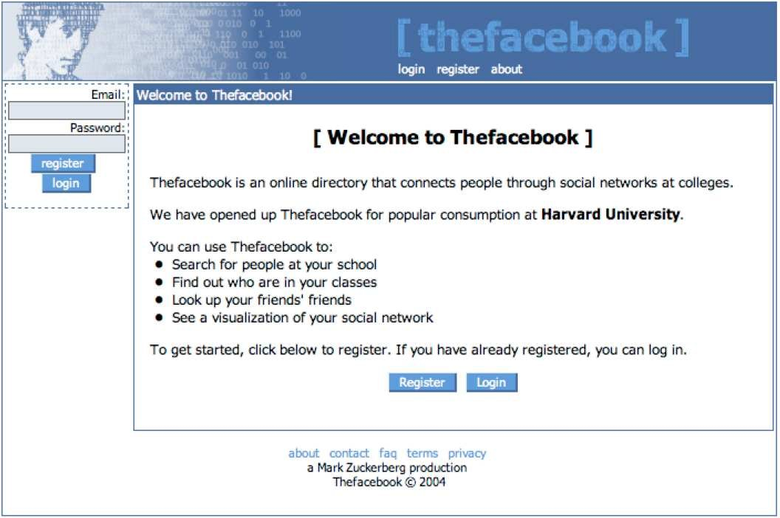
Secrets to success
Keep it simple
Notes:
Many companies get so entranced with all the amazing features they want to build into their products that they make their products so complex that no one can figure out how to use them.
Or they take so long to develop their products that by the time they come out, they have already been leapfrogged.
The first version of the "thefacebook" was very simple. It did one thing well.
Then Zuckerberg and the Facebook team improved it over time. And, each time, they made sure that the service was still easy to use.

Slide 8
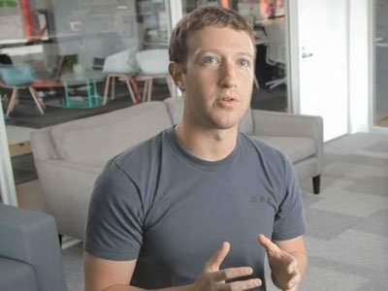
Secrets to success
Focus on product
Notes:
Make your primary focus the product, not the "business" or "shareholder value.”
Mark Zuckerberg was famously uninterested in Facebook's business in the early days. Instead, he focused all of his energy on Facebook's product.
one of the best ways to create huge amounts of shareholder value over the long-term is to focus obsessively on the your product and your customers. If you do that, the business will follow.

Slide 9
Issues
Innovation
The more users you have, the harder it is to innovate
Facebook spent huge money buying upstarts.
Creative labs
Young users are leaving
Notes:
when was the last time you get excited about some new feature in Facebook? Probably a long time ago.
For software companies, one of the perils of success is becoming shackled to your customers; the more users you have, the harder it is to innovate, because most will be averse to any change. And some of the most innovative recent social networking ideas have come from upstarts, which Facebook has spent huge money buying (up to $19 billion for WhatsApp, $1 billion for Instagram) or trying and failing to buy
the lure of start-up money. “If you’re a talented engineer and have a good idea at Facebook, why would you create it while you’re at Facebook and make Mark Zuckerberg richer?

Slide 10
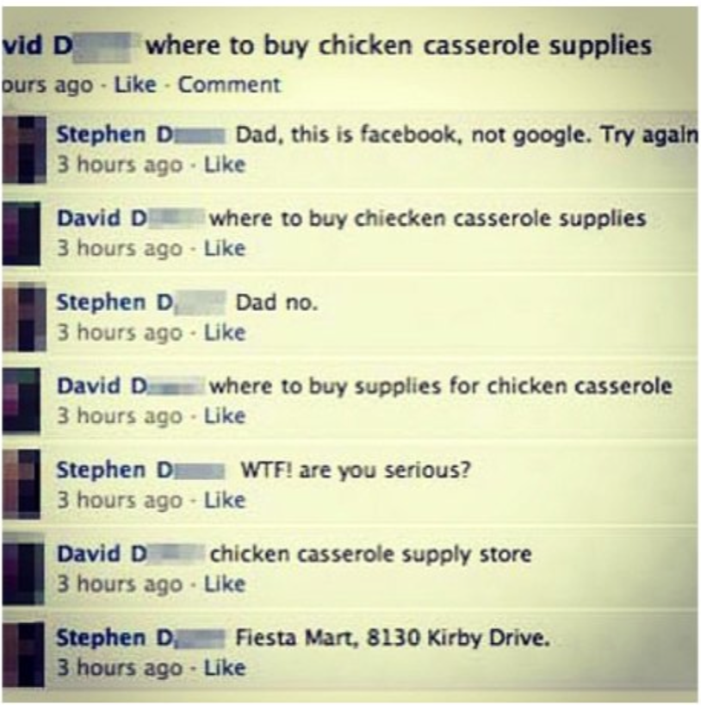
Issues
Notes:
when was the last time you get excited about some new feature in Facebook? Probably a long time ago.
For software companies, one of the perils of success is becoming shackled to your customers; the more users you have, the harder it is to innovate, because most will be averse to any change. And some of the most innovative recent social networking ideas have come from upstarts, which Facebook has spent huge money buying (up to $19 billion for WhatsApp, $1 billion for Instagram) or trying and failing to buy

Slide 11
Issues
Notes:
when was the last time you get excited about some new feature in Facebook? Probably a long time ago.
For software companies, one of the perils of success is becoming shackled to your customers; the more users you have, the harder it is to innovate, because most will be averse to any change. And some of the most innovative recent social networking ideas have come from upstarts, which Facebook has spent huge money buying (up to $19 billion for WhatsApp, $1 billion for Instagram) or trying and failing to buy

Slide 12
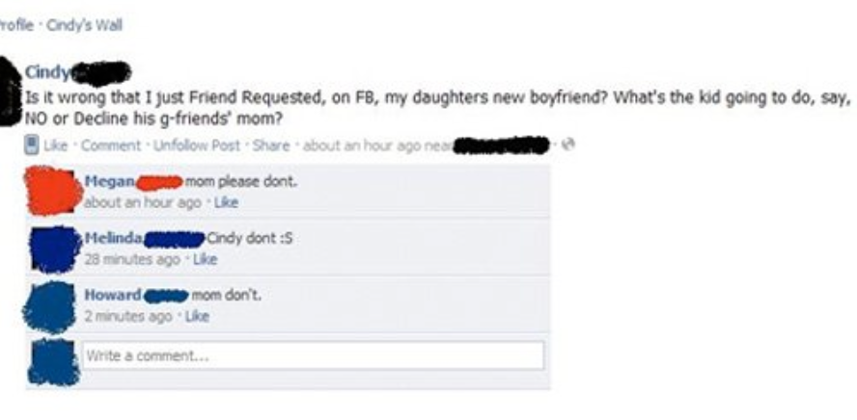
Issues
Notes:
when was the last time you get excited about some new feature in Facebook? Probably a long time ago.
For software companies, one of the perils of success is becoming shackled to your customers; the more users you have, the harder it is to innovate, because most will be averse to any change. And some of the most innovative recent social networking ideas have come from upstarts, which Facebook has spent huge money buying (up to $19 billion for WhatsApp, $1 billion for Instagram) or trying and failing to buy

Slide 13
Thank you!

