Slide 1
Nokia
Declined mobile phone giant
Student: Weihao Gan

Slide 2
Nokia mobile phone

Slide 3
Nokia
Nokia 1100: Global sales – 200 millions, most of the whole world.
World's most selling 16 models of mobile phones, Nokia accounted for 13.
There are 9 Nokia mobile phones whose sales are over 100 millions.
1998-2011: leading for 14 years of global mobile phone sales.
2008-2011: leading the global smartphone sales.
……
In September 2013, Nokia sold what was once the world‘s largest vendor of mobile phones to Microsoft as part of an overall deal totaling US$7.17 billion. The deal closed on 25 April 2014 and completed on 20 July 2014.
Notes:
The company which some time ago used to be the market leader has seen its global market share to just three per cent. Nokia, which overtook Motorola in 1998 to take the crown of biggest phone manufacturer of world, lost its prestigious crown after struggling for last 3 years.

Slide 4
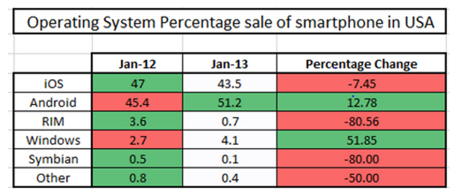
Why Nokia Failed – Top 4 Reasons
#1: Failure of Symbian OS and Wrong Deal with Windows
2002:Nokia – Symbian OS.
2007: Apple – iOS, 2008: Android.
Symbian OS is lack of applications and UI (User Interface).
Biggest mistake to take a leap of faith in Windows in 2011.
Notes:
Nokia launched its Symbian 60 series in year 2002 which initially had a good market response but with the introduction of Apple iOS in 2007 and Android in 2008, the OS race was completely taken over by the two giants. The reasons for collapse of Symbian OS is lack of applications and UI (User Interface). After facing competition from iOS and Android, Nokia continuously tried to improve their Symbian OS but it was mostly following the UI of Android and iOS and was not creating something unique. Secondly, the company failed to look into the need of available applications in gaining market share.
Finally when the tide turned against the company, the company made the biggest mistake to take a leap of faith in Windows in 2011. At that point of time, the company already was in declining condition and trusting Windows which was new in the field to regain its status was the biggest mistake the company made.
Lumia series could have been a hit for the company had they launched on the Android platform. All these phones which the company launched were comparable to other competitor devices but OS was the problem which lead to ultimate collapse of company.
Below are statistics of how the different OS contributed to smartphone sales in USA.

Slide 5
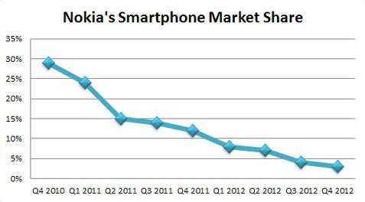
Why Nokia Failed – Top 4 Reasons
#2: NOKIA Became Laggard in Smartphone Market
Stiff competition from Samsung and Apple, and lack on focus on innovation.
Samsung: focus on innovation as its core competence to gain the market share.
Notes:
Stiff competition from Samsung and Apple, and lack on focus on innovation was the second big reason of collapse. Even if users could ignore the OS, the the hardware features which Nokia was rolling out were quiet late as compared its major competitors Samsung and Apple. Nokia seemed to be lagging in the race. Where Samsung from nowhere entered the race and focused on innovation as its core competence to gain the market share, Nokia was very late to realize this fact. Samsung did everything right to focus solely on product innovation and started competing with Apple in all product lines from smartphones to tablets, but Nokia failed to develop a focused device strategy.
Below is the diagram showing how sales dipped from Q4 in 2010 to Q4 in 2012.

Slide 6
Why Nokia Failed – Top 4 Reasons
#3. Losing Market Share on Both Ends.
High end smartphones: Apple, Samsung, Sony, Blackberry.
Low end smartphones: Micromax, HTC, Huawei and ZTE.
#4. Failure to Implement the Right Umbrella Branding Strategy
Apple: umbrella branding using iPhone.
Samsung: their high end phones with Galaxy S series.
Nokia: Lumia series. No customers anticipation.
Notes:
Nokia not only failed to realize competition from Apple, Samsung, Sony, Blackberry in high end smartphones, they also failed to notice the stiff competition in the lower segments of phones. Where Nokia was loosing charm in high end phones, the competition from Micromax, HTC, Huawei and ZTE squeezed the company’s market share in lower segment too. This led to double trouble for the company. The company which used to have epic models like Nokia 1100 suddenly started losing at lower ends too. Very lately company realized this thing and launched their Asha series but by that time they had already lost the game.
Apple was the first phone to use the strategy of umbrella branding using iPhone as an umbrella brand and then building subsequent models each year. Samsung was quick in identifying this concept and they started building their high end phones with Galaxy S series.
Nokia on the other hand used to have used an umbrella brand in the N series and recently the Lumia series, but they failed to create buzz among customers which Apple created. Apple very uniquely launches its new model in September each year and whole year it builds consumer anticipation which drive demand.
But the problem with Nokia’s umbrella branding is that they didn’t, or couldn’t build anticipation in users.

Slide 7
Summary
Decision maker.
Nokia mobile phone:
A tool.
2G/3G, miss the Internet train.
Poor application environment.
UI: ugly and not convenient.
Apple iPhone or Android phone:
Entertainment, habit…
3G/4G/LTE: video…
Apple/Android app store.
UI: friendly and easy to use.
Internet of Things.

Slide 8
Thank you!

