Slide 1
Sensetime it’s time to make sense
Xinyao Chen
08/19/2016

Slide 2
Background
A start-up company founded in 2014
Field:
Computer Vision
Deep Learning
http://www.sensetime.com

Slide 3
Why SenseTime?
A start-up company but grows quickly
Familiar field
Near my school and once visited there
Many friends/classmates take their internships there
Keep sponsoring coding competitions in my school

Slide 4
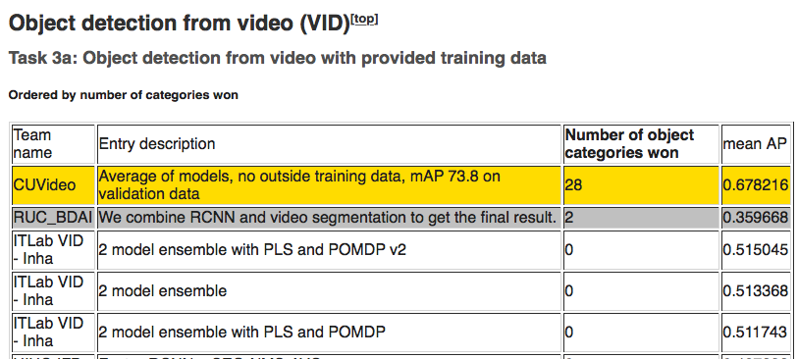
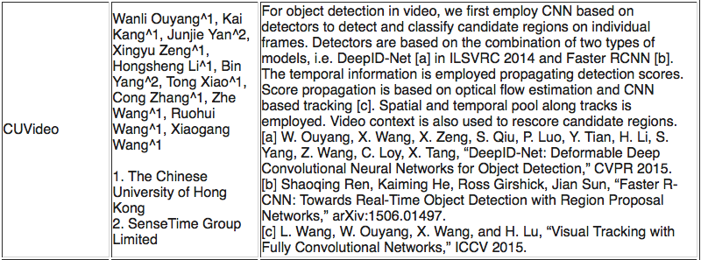
Timeline/Milestone
Not a listed company yet, no sign for IPO
2014.1: Founded
2014.6: Precision of their face recognition system reached 99.15%
2014.11: Got A-round investment from IDG (around tens of million dollars)
2015: Rank 1st on task 3a: object detection from video with provided training data in ILSVR 2015
2016.4: Got B-round investment from Star VC (around tens of million dollars)
Notes:
SenseTime is not a listed company and there is no sign that they’re in preparation for their IPO

Slide 5
Xiaoou Tang
a Professor in the CUHK
Research interest: pattern recognition, computer vision, video processing
Lab: The Multimedia Laboratory
Won the CVPR 2009 Best Paper Award
Alumni including Kaiming He, Dahua Lin, and Shuicheng Yan

Slide 6
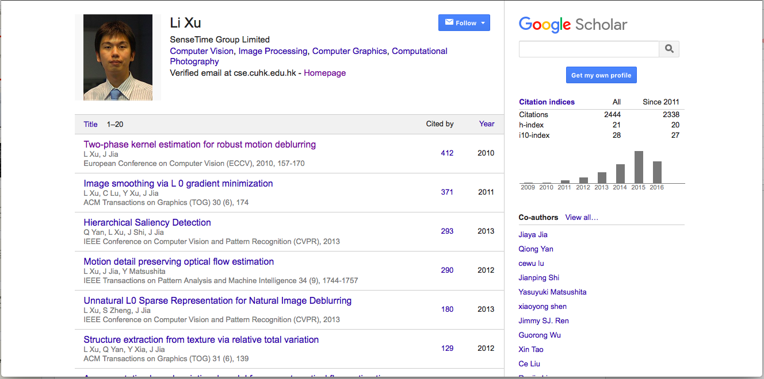
Li Xu
CEO of SenseTime
Also a great researcher
Google Scholar page
“Two-phase kernel estimation for robust motion deblurring” cited by 412 times

Slide 7
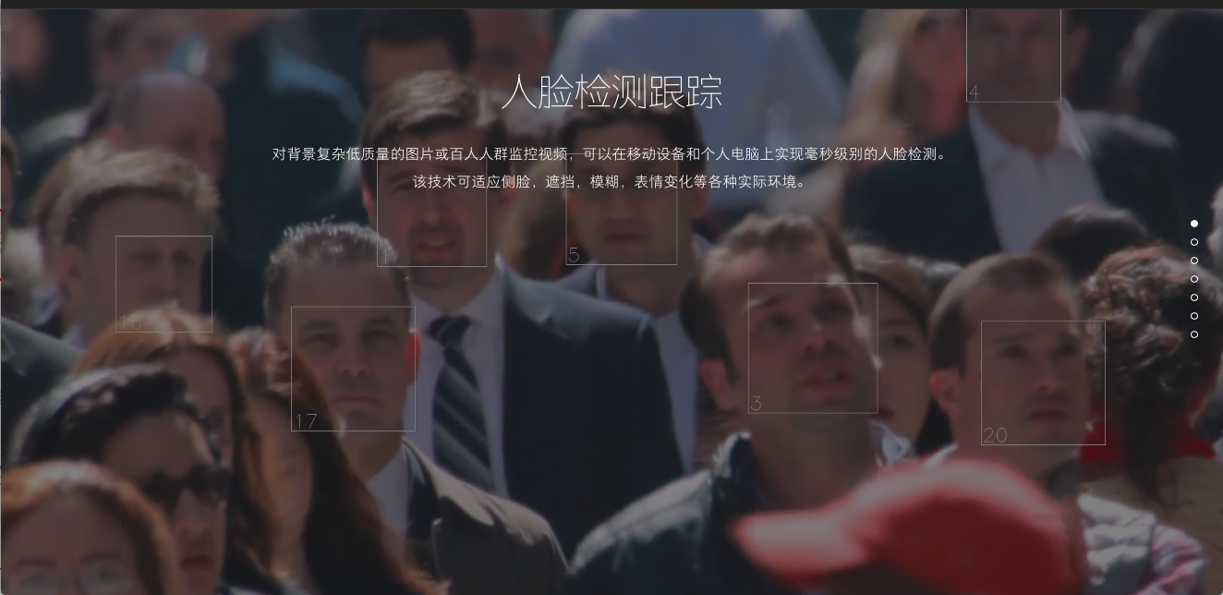
Core Techniques & Applications
Human face related
Real-time face detection and tracking under various environments
Facial landmarks detection
Facial identity verification
Facial characteristics recognition: for targeted advertisement and customer’s information analysis
Facial classification: for images management and social network analysis
Real person detection: for security necessity

Slide 8
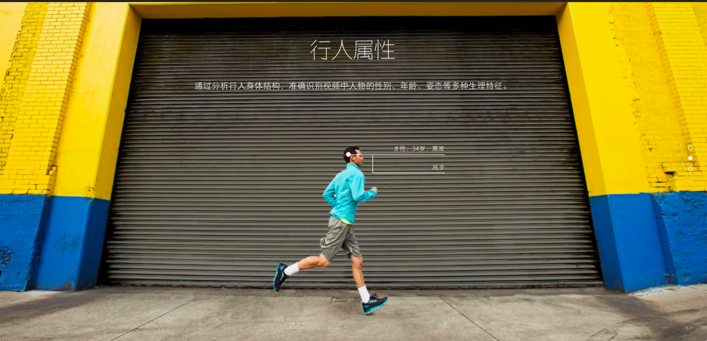
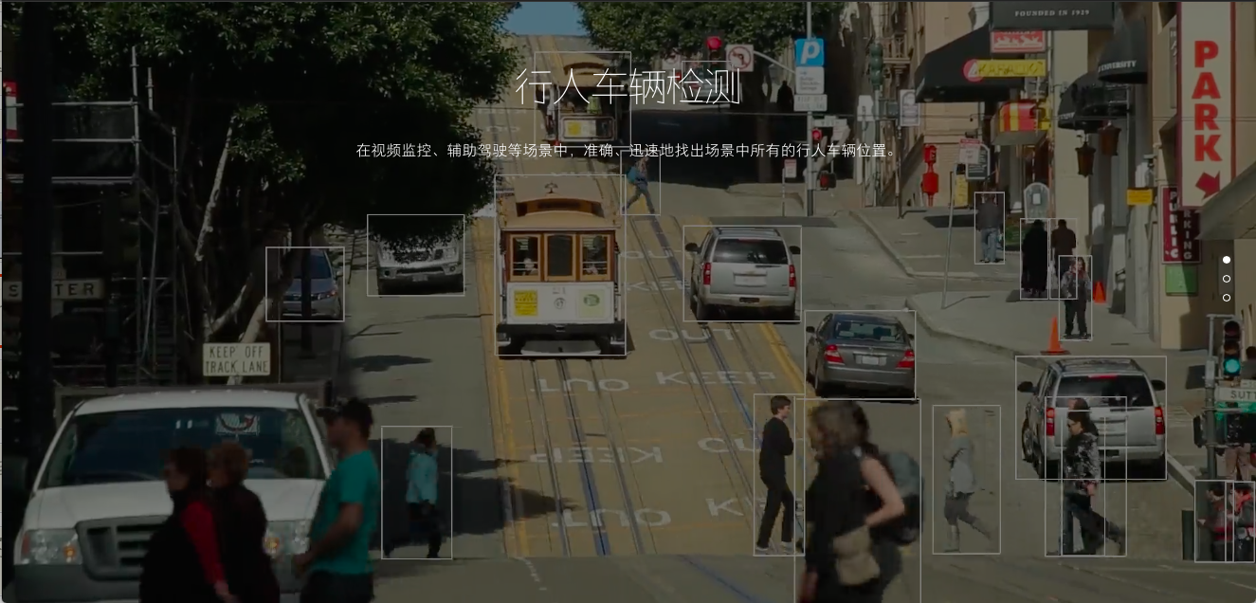
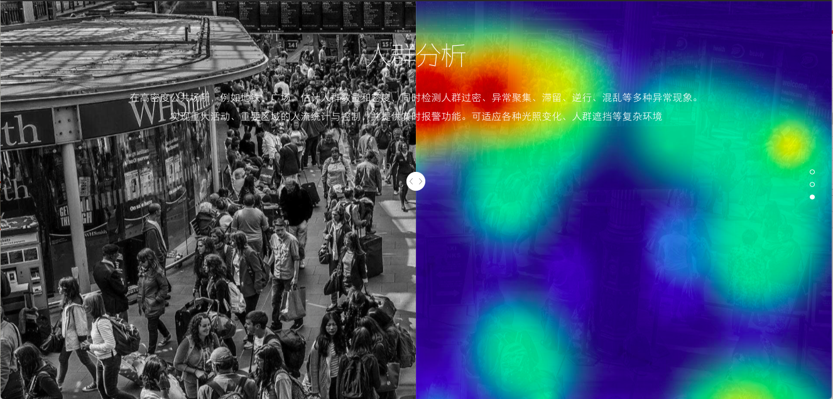
Core Techniques & Applications
Human face related
Smart monitoring
Human & Car detection
Human characteristics analysis
Crowd analysis

Slide 9
Core Techniques & Applications
Human face related
Smart monitoring
Image recognition
Clothes & Object & Scenery & Car recognition under various environment conditions
Character recognition
For bills & cards & license plates
Image/Video Processing
Deblur & Super resolution & Denoising …
Deep Learning Framework

Slide 10
Key to Success
Own core competence: good techniques, outstanding staffs
Good timing: wide application and growing marketing of CV and Deep Learning
Good propaganda: sponsor coding competition in university to attract students
Working environment: sizeable income, good welfare

Slide 11
Potential Challenges
Marketing & Management
Good techniques, good product, how to sale?
Competition
Computer Vision and Deep Learning are both hot fields, how to keep core competence?
Notes:
Running a company is very different from doing research in a lab.
Negative news would come out

Slide 12
thank you!

