Slide 1
鼎泰豐
DIN TAI FUNG
Case Study by Eric 08.19.2016

Slide 2
Din Tai Fung?
“snack bar”
since 1985

Slide 3
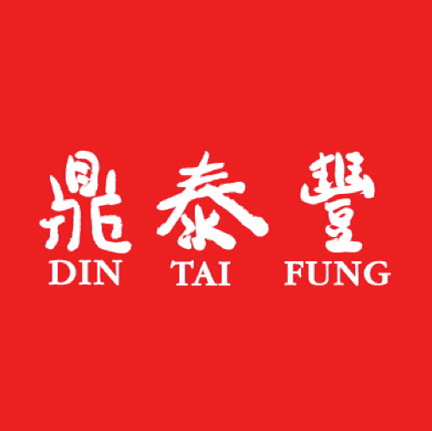
BinYi Yang / JiHua Yang
Oil
Oil / Steamed Dumpling
Steamed Dumpling

Slide 4
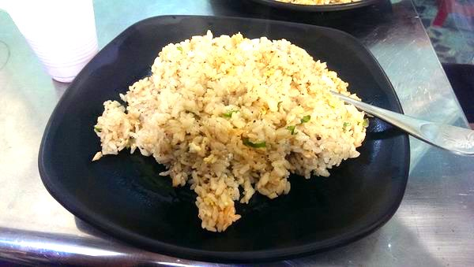
Question
7 USD vs 2 USD

Slide 5
Why Din Tai Fung?

Slide 6
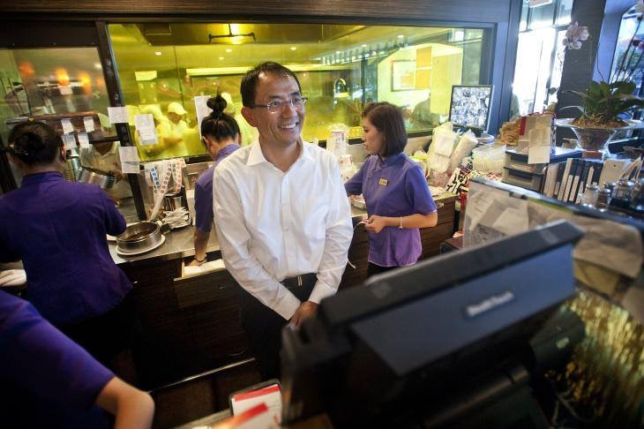
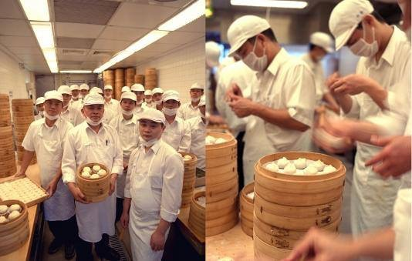
Quality & Service
Customers’ experience
Standard Operating Procedures (SOP)
Making Progress

Slide 7
Customer’s Exp
- Chopsticks
- Refill
- Smile

Slide 8
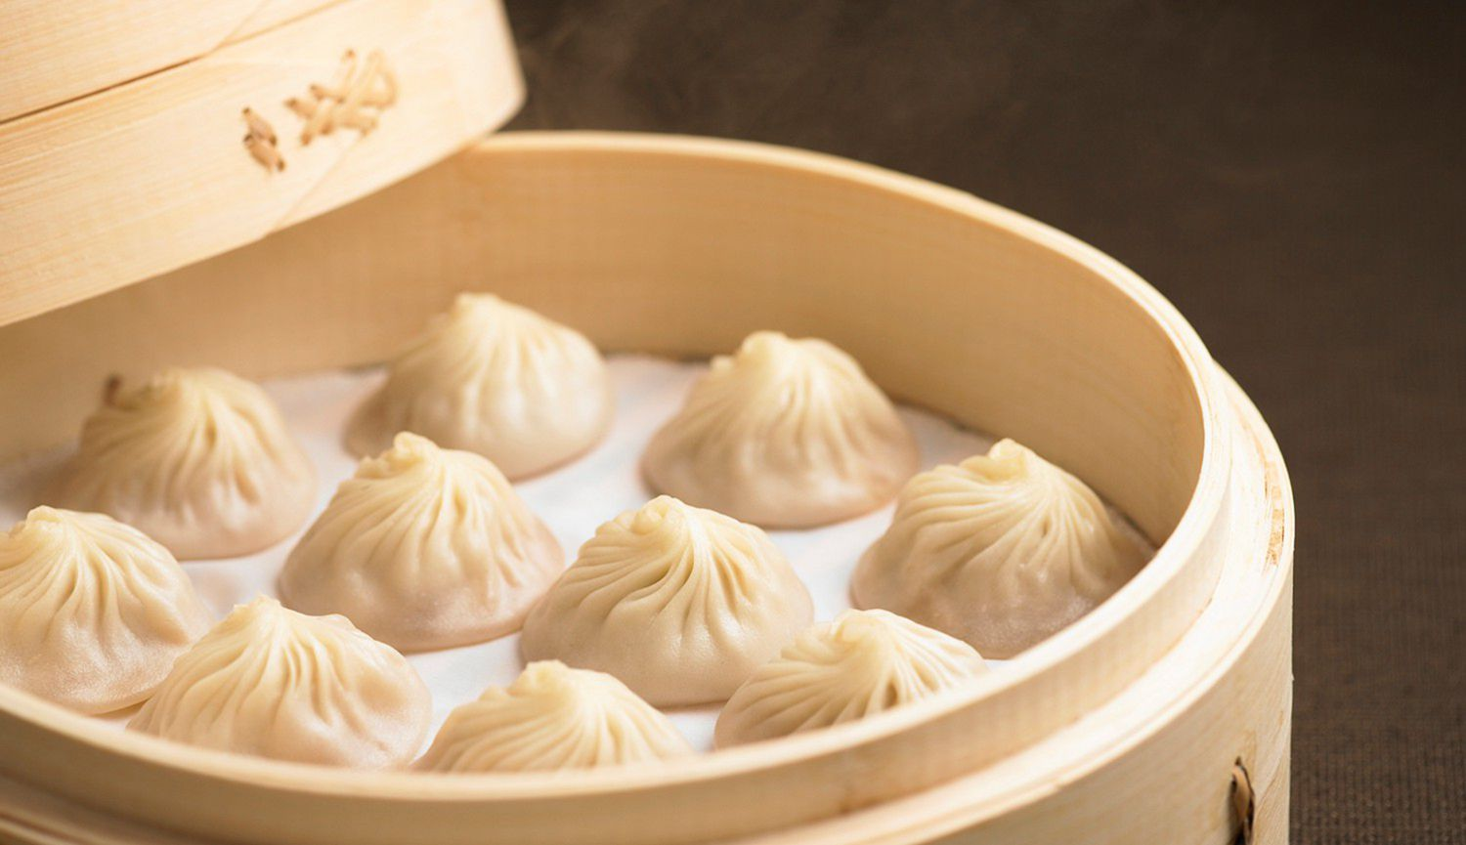
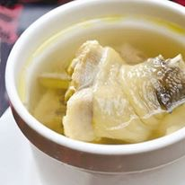
SOP
- Standard = Same quality and taste
- Fried Rice Competition
- Details (Temperature, Weight and Ratio…)

Slide 9
Making Progress
- Paying lots of attention on customers’ feeling
- Always want to be better

Slide 10
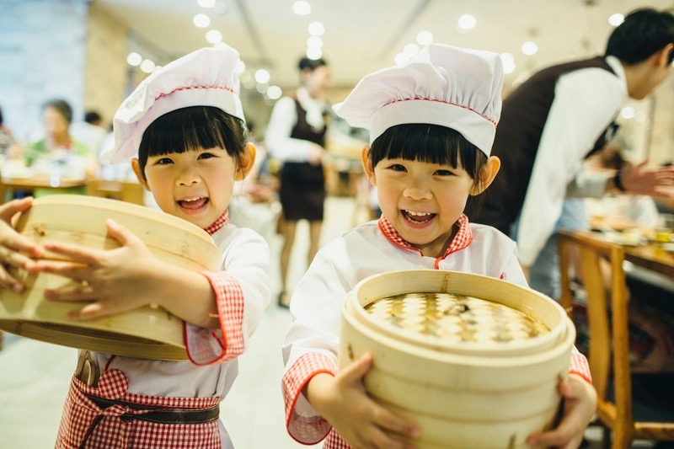
Features of Din Tai Fung
- Break the Rules
- Allocation of Human Resource
- Don’t Go IPO

Slide 11
Honesty is the Best Policy

Slide 12
Challenges
Employee lacking the Sense of Achievement
Always Have to Break Through

Slide 13
Thanks for Your Listening

